Slide 1
Data Science & AI
The algorithm makes all the difference
Bill Roberts

Slide 2
Strategic Analytics and Insights
1980
1985
1990
1995
Source: http://www.basketball-reference.com/leagues/NBA_stats.html.
No one really executed a game plan… around the 3-pointer. Golden State made 1,025 3-pointers in 2016, an NBA record
Wall Street Journal, April 2016

Slide 3
How to think about cognitive data science in a business context

Slide 4
Identifying signals and patterns and providing alerts
Data
National Weather Service
Science
Integrated Workflow
3D finite difference methods
Spectral methods
Liouville equations
Monte Carlo simulations
Emergency Alert System
EMERGENCY ALERT
NOAA
SKYWARN

Slide 5
On the evening of October 29, 2012, Hurricane Sandy made landfall in southern New Jersey, with impacts felt across more than a dozen states. The storm battered the East Coast, particularly the densely-populated New York and New Jersey coasts, with heavy rain, strong winds, and record storm surges. During Sandy’s immediate aftermath, more than 23,000 people sought refuge in temporary shelters, and more than 8.5 million customers lost power. The storm flooded numerous roads and tunnels, blocked transportation corridors, and deposited extensive debris along the coastline.
$71B in US damages and 71 US fatalities

Slide 6
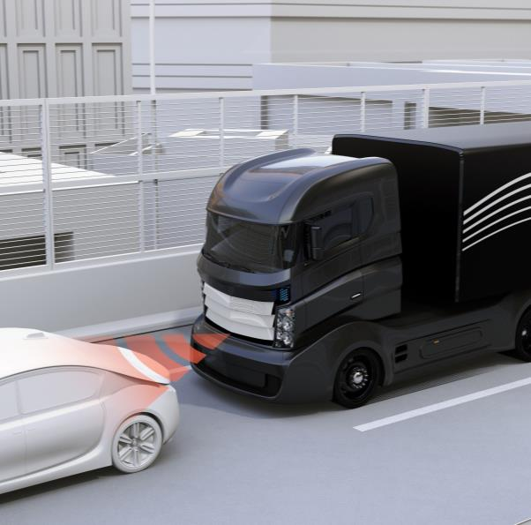
How some companies are aiming to monetizing these solutions…

Slide 7
So why not use the same tools for applications like these…
Forecast Demand
Customer Management
Financial Planning/ Profitability

Slide 8
A new approach to commercial analytics problem solving
Typical Analytics Approach
Gather Sample Data
Assemble Smart People
Analyze and Produce Insight
Debate, Socialize, Convince
Report
Maybe Act
Episodic and time consuming, reverts to the “Smartest person in the room” biased approach
Cognitive Data Science Approach
Link Internal Data
Ingest External Data
Develop Signal Cube
Test Algorithms
Develop Treatments & Plans
Integrate into Workflow
Extend Data for Next Use

Slide 9
We aim to build solutions with these three key components
Data and Signals
Science
Integrated Workflow
f(x)
Internal & external data
Structured & unstructured data
ETL
Signal Generation & Feature Engineering
Directed action
Continuous intelligence
Applications
Systems integration
Data science
Algorithms & models
Machine learning
AI

Slide 10
Science: Business Issues ➔ Problem Classes ➔ Algorithms
Business Issues
Problem Class
Customer 360
Problem Formulation
Regression
Segmentation
Classification
Reinforcement Learning
Forecasting
Optimization
Simulation
Incomplete Data
Anomaly Detection
NLP
Geospatial
Algorithm Choice based on Data Characteristics
Autoregressive and ARMA
CART
CIR++
Compression Nets
Decision Trees
Discrete Time Survival Analysis
D-Optimality
Epsilon Greedy
Factor Analysis
GARCH
Gaussian Mixture Model
Genetic Algorithm
Gradient Boosted Trees
Hierarchical Clustering
Kalman Filter
K-Means
KNN
Linear Regression
Logistic Regression
Maximum Likelihood estimation
Monte Carlo Simulation
Multinomial Logistic Regression
Neural Networks
LP/IP/NLP Optimization
Poisson Mixture Model
Random Forests
Restricted Boltzmann Machine
SVD, A-SVD, SVD++
SVM
Inventory
Cost reduction
Call Center Costs
Talent
Cash Flow
Profitability

Slide 11
Incomplete data
Processing data that is sparse and incomplete

Slide 12
Netflix Movie Recommendation Competition
Estimating customers’ movie ratings
 | Avatar | Citizen Kane | Mean Girls | Jurassic Park
Stephanie
Andy
Ryan
Caitlin
Ashley
2
3.1
5
4.3
3.5
3
2.8
1
5
4
4.8
4.1
2.1
3.6
4
3.2
2
4.2
2.6
3
Known
Estimated

Slide 13
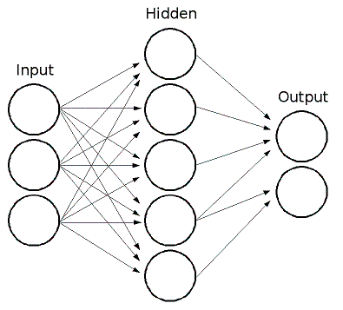
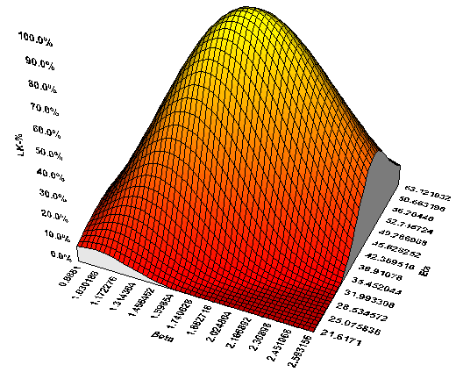
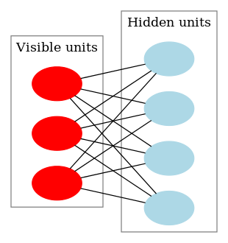
Algorithms
Singular Value Decomposition
Singular Value Decomposition
Neural Networks
Singular Value Decomposition
Maximum Likelihood Estimation + Conditional Mean Prediction
Maximum Likelihood Estimation + Conditional Mean Prediction
Restricted Boltzmann Machine
Maximum Likelihood Estimation + Conditional Mean Prediction

Slide 14
Finding Medical Billing Errors
Medical services are generally invoiced using ICD9 codes. If a code is inadvertently left off an invoice, the provider may not get paid for the corresponding service
ICD9 Codes | Invoice 1 | Invoice 2 | Invoice 3 | Invoice 4
4.81 – Anesthetic injection
13.41 – Cataract removal
13.71 – Insertion of IOL
28.3 – Tonsillectomy
79.3 – Broken bone surgery
88.2 – Skeletal x-ray
89.0 – Diagnostic consultation
89.7 – General physical exam
90.3 – Test on specimen from ENT
90.5 – Blood test
92.1 – Physical therapy exercises
95.0 – Eye exam
95.15 – Ultrasound of the eye
1
0.4
0.35
1
0.01
0.07
1
0.02
0.01
0.03
1
0.03
1
0.08
0.07
0.06
0.01
0.01
0.01
1
0.05
0.06
0.04
0.86
1
0.15
1
1
1
1
0.68
0.62
1
0.13
0.14
0.15
0.54
1
0.43
0.39
0.11
0.10
0.15
1
0.28
0.12
1
0.18
0.01
0.01
1
0.01
Known
Estimated

Slide 15
Incomplete Data Algorithms in action
Government entity
Problem
Result
Government benefit application forms completed in a fraudulent manner leading to over $100’s M in over payment
Applied incomplete data algorithms to check form integrity
Identified form fields that we incorrectly completed. Previously required manual assessment by agents. Significant workload reduction
Tech company sales comp
Problem
Result
Account sales data very sparse
Regular modeling approaches were inaccurate
Sales representatives getting erroneous sales targets, retention problems and bonus overpayment
Developed a sparse data forecasting algorithm that achieved high performance
Achieved a 10% reduction in sales team bonus compensation
Medical Insurer
Problem
Result
Challenges in billing integrity, potential additional codes added to invoices costing $M’s annually
Applied sparse data algorithms to find unlikely high-vale charge codes
Unlikely charges codes sent to dispute resolution process, leading to 3% in payment savings

Slide 16
Classification
Distinguishing one class from another

Slide 17
Classification Algorithms using Deep Learning
Deep learning grew from 1990’s neural network research. In 2006 Hinton demonstrated a fast training algorithm for very large (or deep) neural networks
As Hinton said of the earlier work:
Our labeled datasets were thousands of times too small.
Our computers were millions of times too slow.
We initialized the weights in a stupid way.
We used the wrong type of non-linearity.

Slide 18
Deep learning in action
Government entity
Problem
Result
100M Benefit recipients
Compliance and identity theft challenges
Billions of dollars of improper payments
Detected identity theft with high accuracy
Identified form entries that had potential compliance issues
Medical insurance plan
Problem
Result
Hospital readmissions are expensive and providers and plans are being incentivized to reduce
Champion model against other classification models. Detected events widely separated in time
Credit card company
Problem
Result
Increase in “bust out” fraud where bad actors build up credit trustworthiness through legitimate transaction
Identified bust-out fraud up to 7 days earlier that other approaches. Deep learning was able to pattern match events widely dispersed in time

Slide 19
Segmentation
Finding natural groupings in data

Slide 20
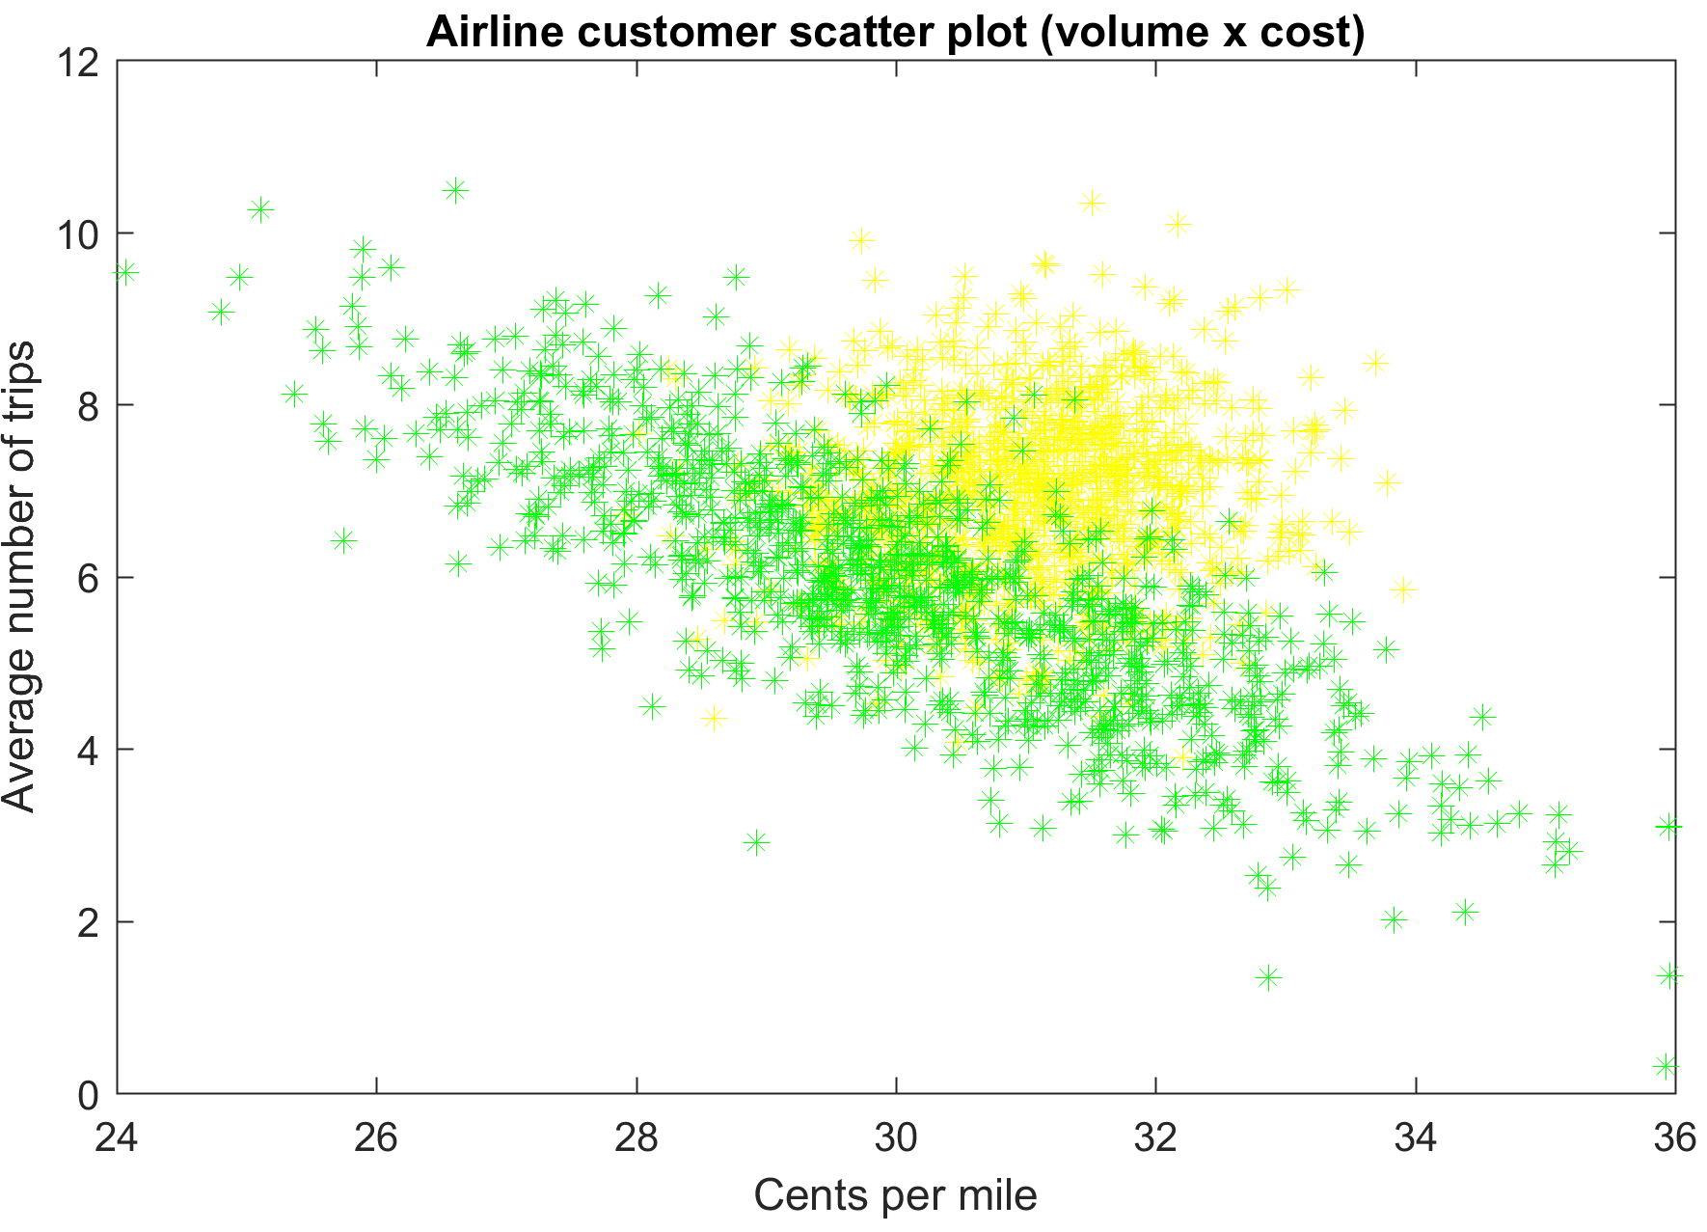
Segmentation using K-means Algorithm and Gaussian Mixture Modeling

Slide 21
Segmentation in Action
Major Airline
Problem
Result
100M customers with low margins on seat upsell
Mixed customer sentiment and low NPS
Identified segments of low and high price elasticity
Developed interventions to exploit differential price elasticities
Bank
Problem
Result
Customers indicated low satisfaction rates in surveys
Identified 3 key segments of customers from 100,000 account data and designed appropriate accounts
High offer take rate and improved survey results
National Media Org.
Problem
Result
TV viewers switching channels during news programming
Identified segment that had viewing patterns correlated to news content
Leveraged for advertising sales

Slide 22
Classify, segment and learn
Treating customers to change their behavior

Slide 23
Classify, Segment and Learn
Classification determines which customers should receive treatments, segmentation recognizes customers that will respond similarly to treatments, and the learning matches treatments to segments
Customers classified and segmented based on profile data
Customer Profile Data
Classification
Segments of similar customers
Transactions Data
Customer likely to leave
Profile Data
3rd Party Data
Customer Service
Customer likely to stay
Personality Estimates
Customers receive a treatment based on their segment
Segment A
Monthly fee discount
Segment B
Discounted handset upgrade
Segment C
Free minutes

Slide 24
Matching segments to treatments using explore/exploit algorithms
Segment D Customer likely to leave
Response Matrix
Offers Designed With Customer in Mind
Treatments
Handset discount
Fee discount
Free Minutes
Take no action
Monthly fee discount
E | 10% | 22% | 29% | 11%
D | 19% | 25% | 22% | 9%
C | 7% | 12% | 34% | 31%
B | 15% | 25% | 31% | 23%
A | 35% | 6% | 18% | 4%
Response
EXPLORE
Segments
EXPLOIT
Discounted handset upgrade
Feedback Loop

Slide 25
Explore/Exploit in Action
Telecom company
Problem
Result
Higher than industry average attrition rates
Identified key segments and matched them to offers, e.g., bill reduction, new headset, free minutes, etc.
Healthcare provider
Problem
Result
Reduce Medicaid fraud through identifying and “treating” Opioid abusers
Reduced Opioid abusers through detection, segmentation and explore/exploit. Treatments include pharmacy lock in, care management etc
Government entity
Problem
Result
High rates of fraud and non-compliance resulting in large numbers of people in default
Identified segments who responded well to soft-touch “nudges” and other segments who require call or visits from collection personal

Slide 26
How are analytics current being leveraged?
Provide requested reports to the enterprise
Gather and aggregate enterprise data
Analyze historical data to discover trends
Develop and deliver business insights to help enterprise leaders run the business more effectively
Perform predictive analytics and/or optimization
Perform currently
Anticipate performing in two years
Deloitte Client Survey

Slide 27
What are the roadblocks?
Data reliability and consistency
Supporting technology platform
Understanding of business background
Access to skilled talent
Securing financial resources for required investment
Data availability
Absence of leadership focus

Slide 28
About Deloitte Deloitte refers to one or more of Deloitte Touche Tohmatsu Limited, a UK private company limited by guarantee (“DTTL”), its network of member firms, and their related entities. DTTL and each of its member firms are legally separate and independent entities. DTTL (also referred to as “Deloitte Global”) does not provide services to clients. In the United States, Deloitte refers to one or more of the US member firms of DTTL, their related entities that operate using the “Deloitte” name in the United States and their respective affiliates. Certain services may not be available to attest clients under the rules and regulations of public accounting. Please see www.deloitte.com/about to learn more about our global network of member firms. Copyright © 2019 Deloitte Development LLC. All rights reserved. 36 USC 220506

